Slide 1
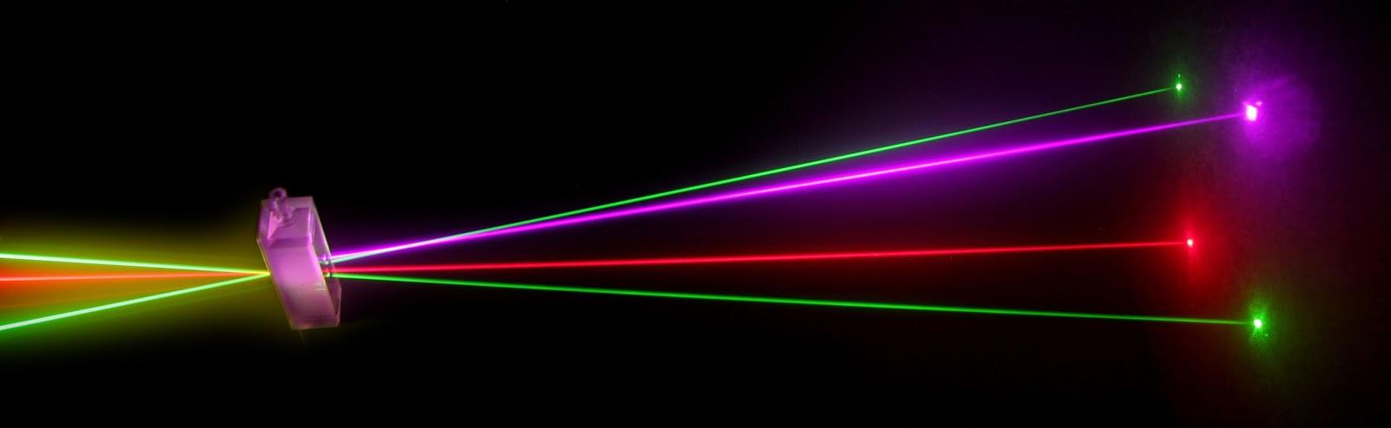
“Laser Technology and Applications” 16B1NPH533 Lecture 36
He-Ne laser

Slide 2
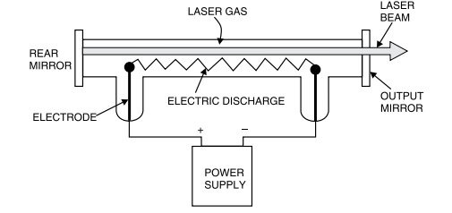
Schematic of Gas Lasers
In gases, energy levels of atoms involved in lasing action are well defined and narrow; broad pump bands do not exist
To excite gaseous atoms; pump sources with sharp wavelengths are required
⇒ Optical pumping not suitable for gas lasers.
Most common method; Electric discharge through the gas medium.
Gas contained in a tube with cavity mirrors.
High DC voltage ionizes the gas
for conduction.
Electrons in the discharge transfer energy to atoms in the gas by collisions.

Slide 3
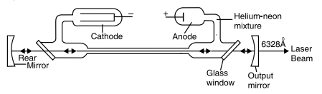
He-Ne Laser
First gas laser ever developed; Still one of the most widely used lasers.
He-Ne: An atomic laser employs Four-level pumping scheme.
Active Medium; a mixture of 10 parts of He to 1 parts of Ne
Ne-atoms; active centres- have energy levels suitable for laser transitions
He-atoms help efficient excitation of Ne-atoms
Schematic of a He-Ne laser with external mirrors
Discharge tube of about 30cm long, 1.5 cm in diameter, filled with a mixture
of He & Ne gases in 10:1 ratio.
Electrodes connected to HV (~10kV) to produce discharge in gas.

Slide 4
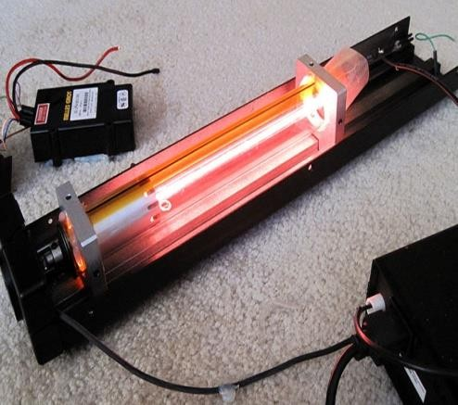
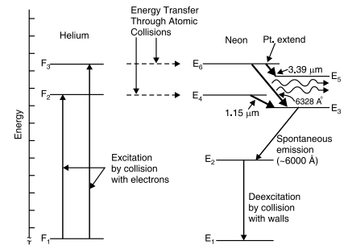
HV of 10kV applied across the gas- ionizes the gas
Electrons & ions accelerated towards anode and cathode
Electrons being smaller in mass acquire higher velocity
Electrons transfer K.E. to He atoms through inelastic collisions.
He atoms excited to levels F₂ & F₃ – metastable levels
Transfer energy to Ne-atom through collisions
Resonant transfer of energy
Possible in He-Ne atoms
Ne-atoms being heavy, could not be pumped up efficiently without He-atoms.

Slide 5
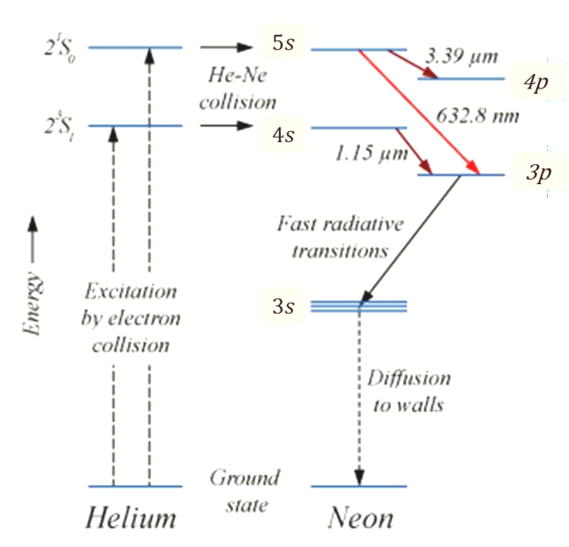
Role of He-atoms is to excite Ne-atoms and cause P.I.
Probability to transfer energy from He-Ne is more ;
10 He per 1 Ne atoms.
Reverse probability i.e. Ne-He is extremely small
E₄ (4s) & E₆ (5s) levels in Ne; Metastable States (Accumulation of atoms)
Population inversion between
E₆ and E₅ (4p), E₃ (3p) levels
E₄ and E₃ levels
Lasing takes place & light produced
corresponding to
E₆ →E₃ laser beam of red colour at 632.8 nm
E₄ → E₃ laser beam at wavelength of 1150 nm
E₆ → E₅ laser beam in IR region at 3390 nm
In reality, ~150 laser transitions are possible, however, only three are dominant transitions.

Slide 6
Ne-atoms in level E₃ decays rapidly to E₂ (a metastable state)
Accumulation may take place unless removed by some means
E₂ →E₁ transition induced by collisions with walls of discharge tube.
Discharge tube made as narrow as possible to enhance probability of atomic collisions with walls.
E₂ level is more likely to be populated by the electric discharge itself
An increase in population at E₂ causes decrease in P.I. →Lasing ceases.
Current in discharge tube maintained at low level
Reason for not getting high power He-Ne lasers
Major applications as Red light at 632.8 nm
Resonator mirrors coated with multi-layer dielectric coatings.
He-Ne laser: Simple, less expansive, practical, high quality beam.
Applications:
Laboratories, Interferometry, Laser Printing, Bar Code Reader, Scanners, Surface Testing, Surveying, Alignment etc

